Slide 1
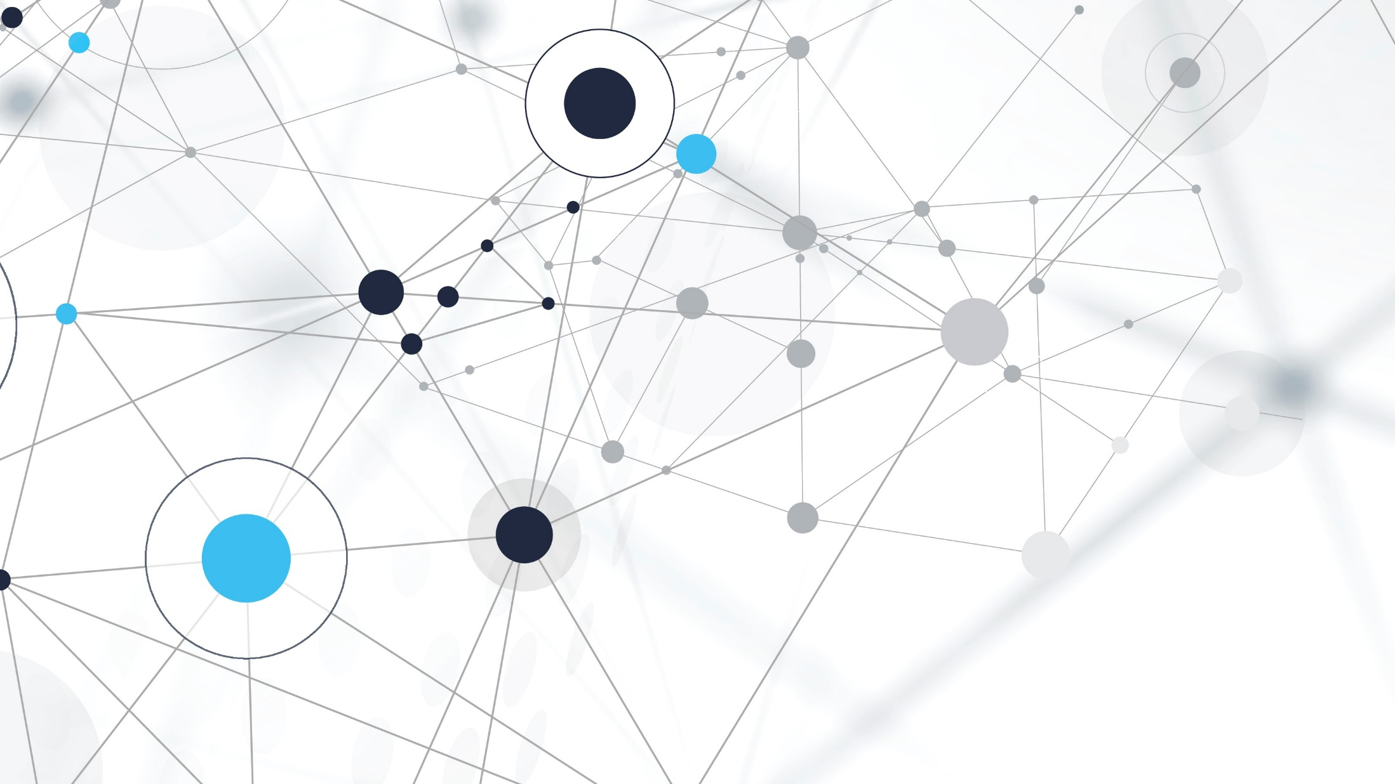
Fakultas Ilmu Komputer
Learning is the process of acquiring new understanding, knowledge, behaviors, skills, values, attitudes, and preferences.
Special Case
[Python Tkinter & Flask Frameworks]

Slide 2

Graphical User Interfaces (GUIs) and Framework Programming with Python

Slide 3
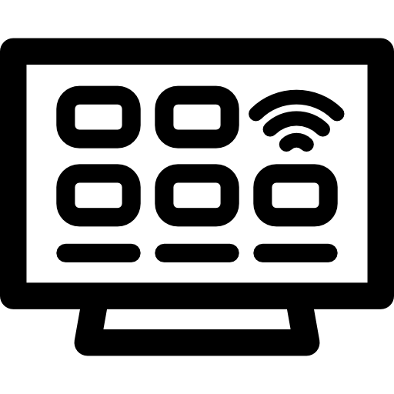
Framework Programming
A programming framework is a prepackaged set of solutions that solves common development problems.
Why do people use frameworks? I can say that the No. 1 reason for using a framework is probably saving time. But as you’ll soon see, there are several other benefits you can get by leveraging frameworks.
Web Application Framework or simply Web Framework represents a collection of libraries and modules that enables a web application developer to write applications without having to bother about low-level details such as protocols, thread management etc.

Slide 4
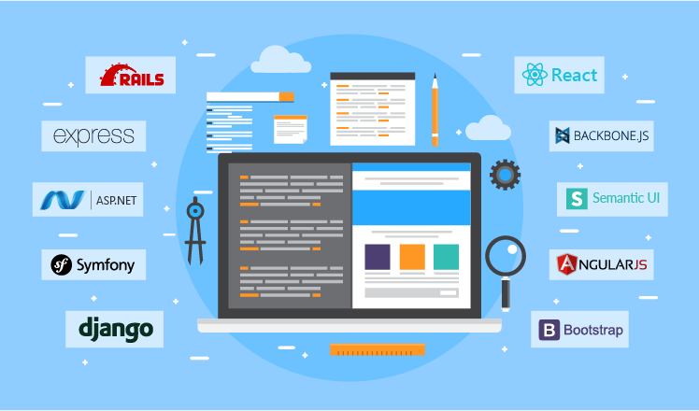
What do you think about Framework Programming?

Slide 5
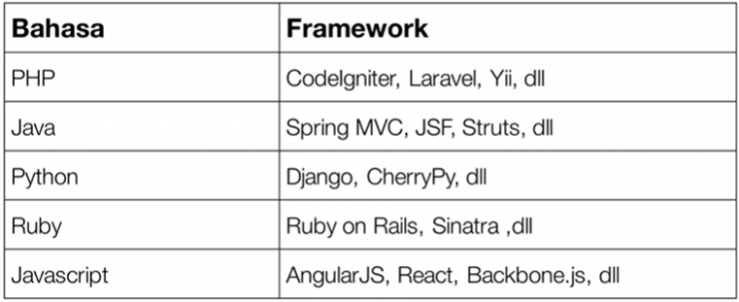
Framework MVC

Slide 6
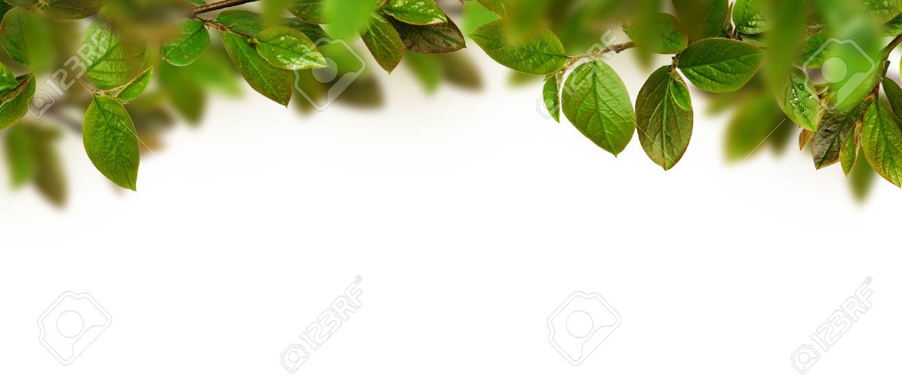
1 - Install Tkinter on Windows
[Graphical User Interfaces (GUIs)]

Slide 7
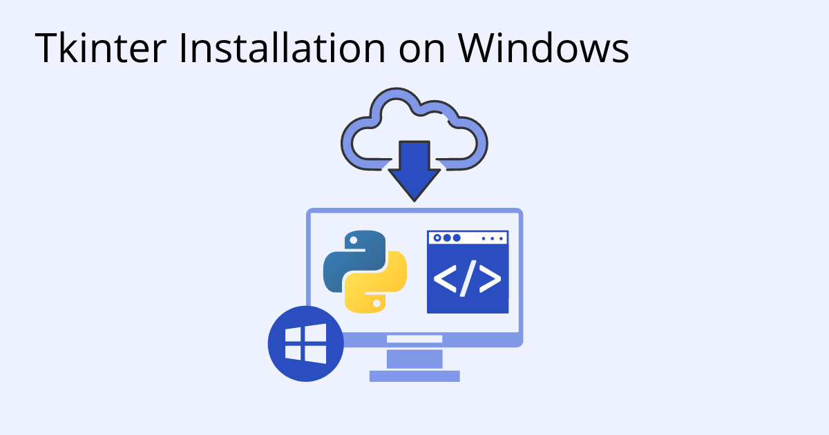
Tkinter is a package in Python to create Graphical User interfaces (GUIs). Installing Tkinter on Windows is as simple as installing Python 3.x since Tkinter is included in the Python 3 core.

Slide 8
What is Tkinter in Python?
Python has a lot of GUI Frameworks, but Tkinter is the only framework that’s built into the Python standard library.
Tkinter has several strengths. It’s cross-platform, so the same code works on Windows, macOS, and Linux.
Visual elements are rendered using native operating system elements, so applications built with Tkinter look like they belong on the platform where they’re run.

Slide 9
Take Advantage of Latest Version of Tkinter
Need to install a version of Python that supports Tcl/Tk 8.5 or greater, as well as Ttk (Tile extension integrated into Tk), which is required in order to run the current Tk widget set.
Python 3.7 or greater for Windows comes full packages to run Tk fully configured out-of-the-box.
If you have Python 3.6 or an earlier version, you can simply upgrade to a newer Python version that includes the latest version of Tkinter.

Slide 10
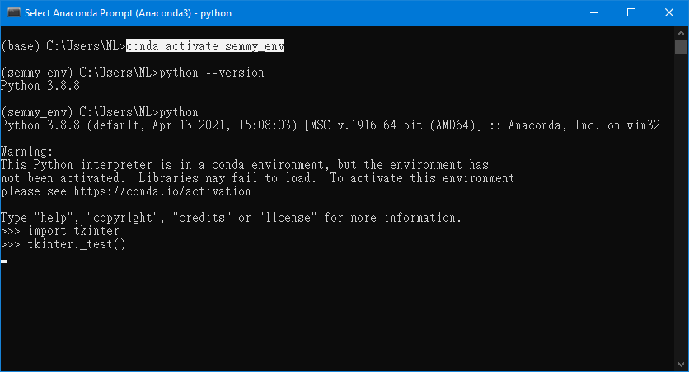
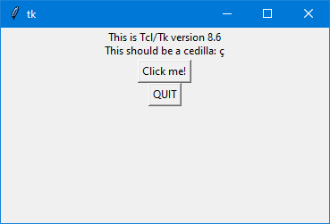
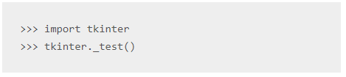
Follow these steps
Install Anaconda Python, Jupyter Notebook And Spyder on Windows 10 https://www.youtube.com/watch?v=g6ln1dAt-RI
Conda create new python environment https://www.youtube.com/watch?v=k-MWeAWEta8 https://www.activestate.com/resources/quick-reads/how-to-install-tkinter-in-windows/
Activate the new environment that has Python 3.8 $ conda activate <env_name>
Check Python version $ python --version
Install Tkinter on windows $ pip install tk
Verify tkinter installation

Slide 11
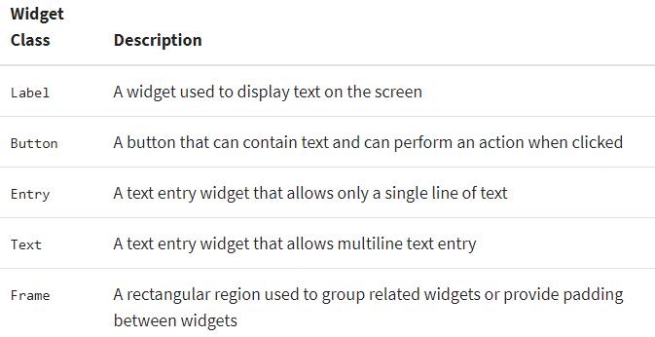
Working With Tkinter Widgets
Some of the widgets available
Widgets are the bread and butter of the Python GUI framework Tkinter. They are the elements through which users interact with your program. Each widget in Tkinter is defined by a class.

Slide 12

(#1) exercise for students
[GUI Framework]

Slide 13
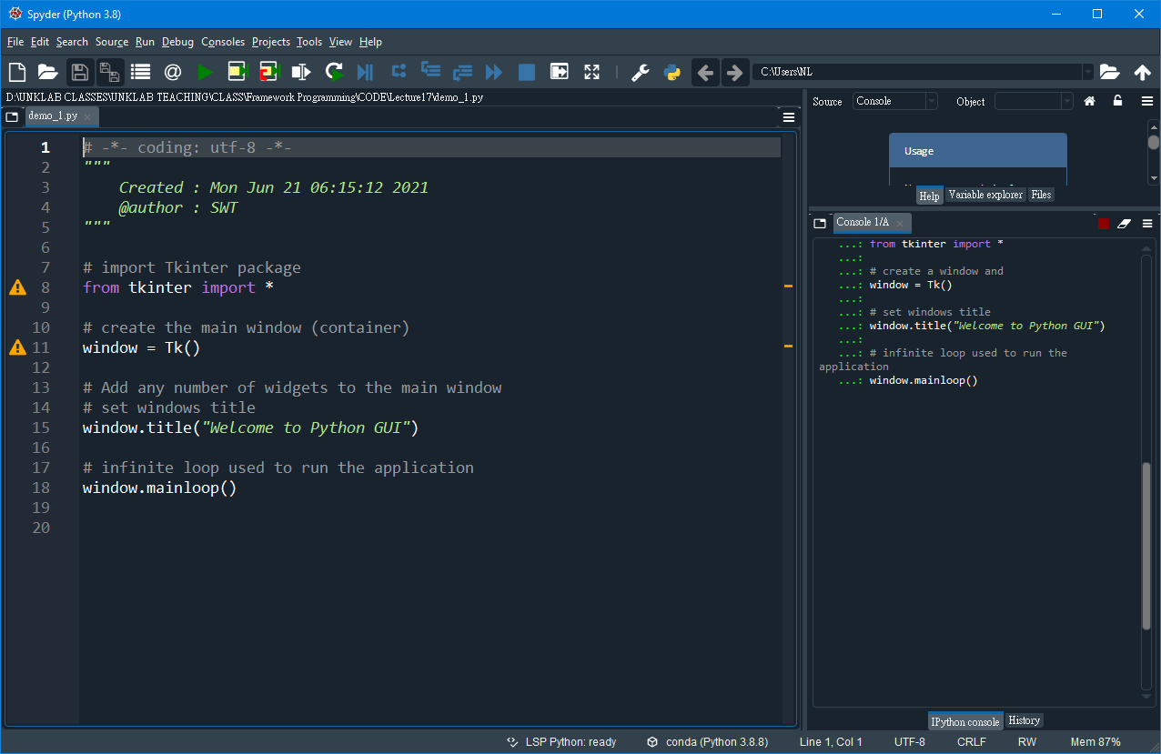
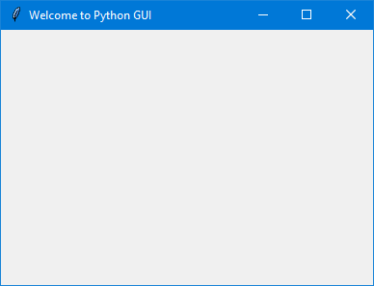

Exercise #1
File : demo_1.py
Desc : Display/create first GUI application with python
Output Program:
Last line which calls the mainloop function, this function calls the endless loop of the window, so the window will wait for any user interaction till we close it. If you forget to call the mainloop function, nothing will appear to the user.

Slide 14
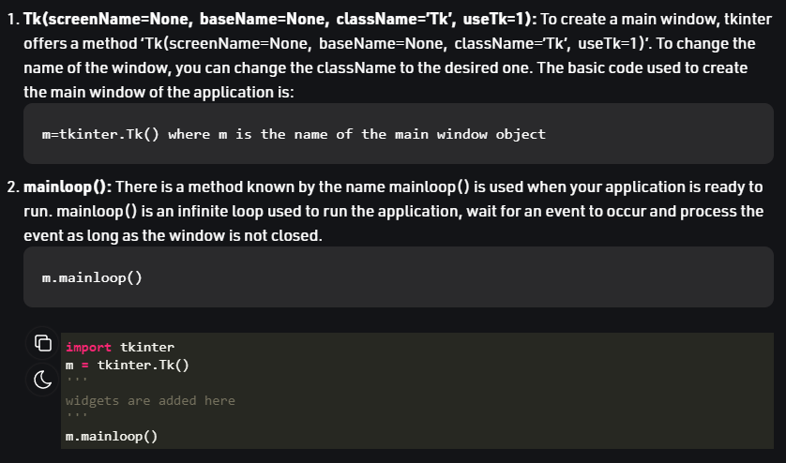
Remember: “two main methods”
Users need to remember while creating the Python application with GUI.
Importing tkinter is same as importing any other module in the Python code. Note that the name of the module in Python 2.x is ‘Tkinter’ and in Python 3.x it is ‘tkinter’.

Slide 15
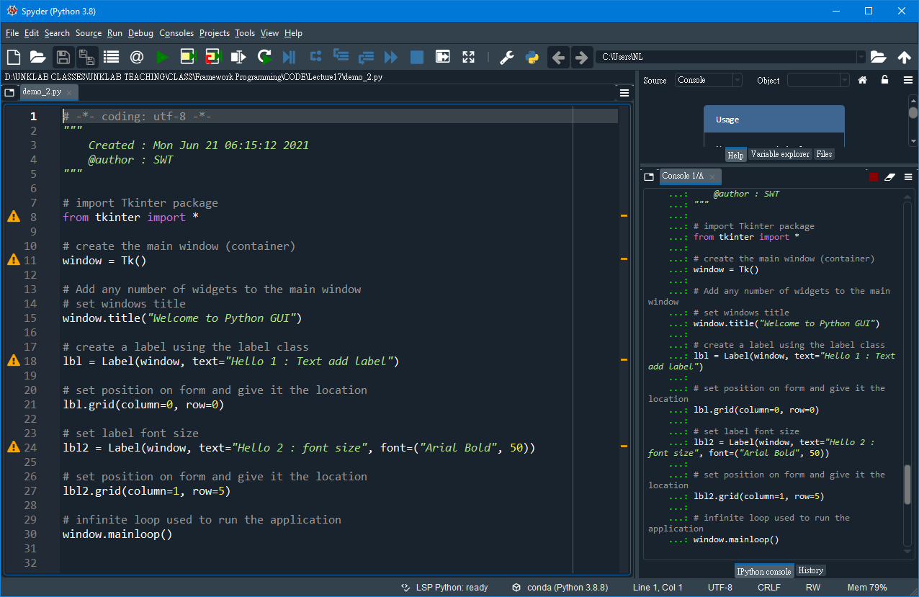
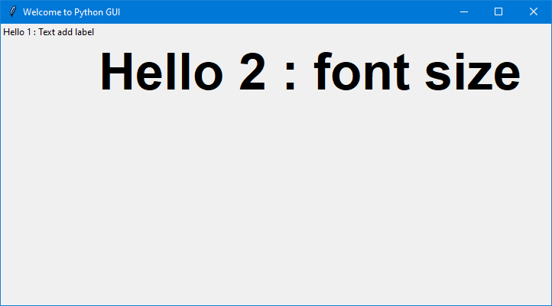
Exercise #2
File : demo_2.py
Desc : Create a label widget
Output Program:

Slide 16
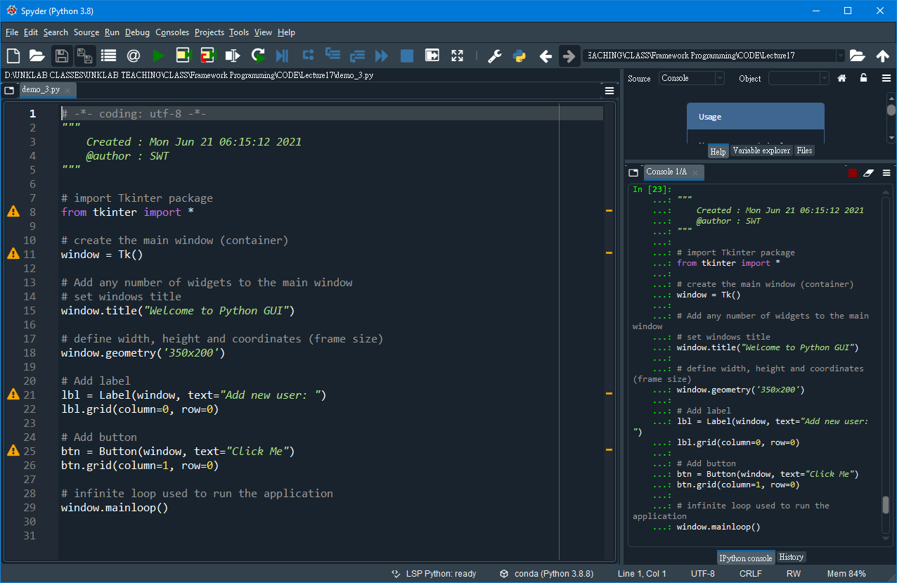
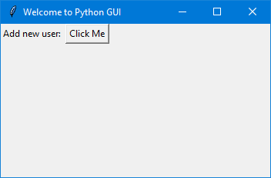
Exercise #3
File : demo_3.py
Desc : Create a button and add a button widget
Output Program:

Slide 17
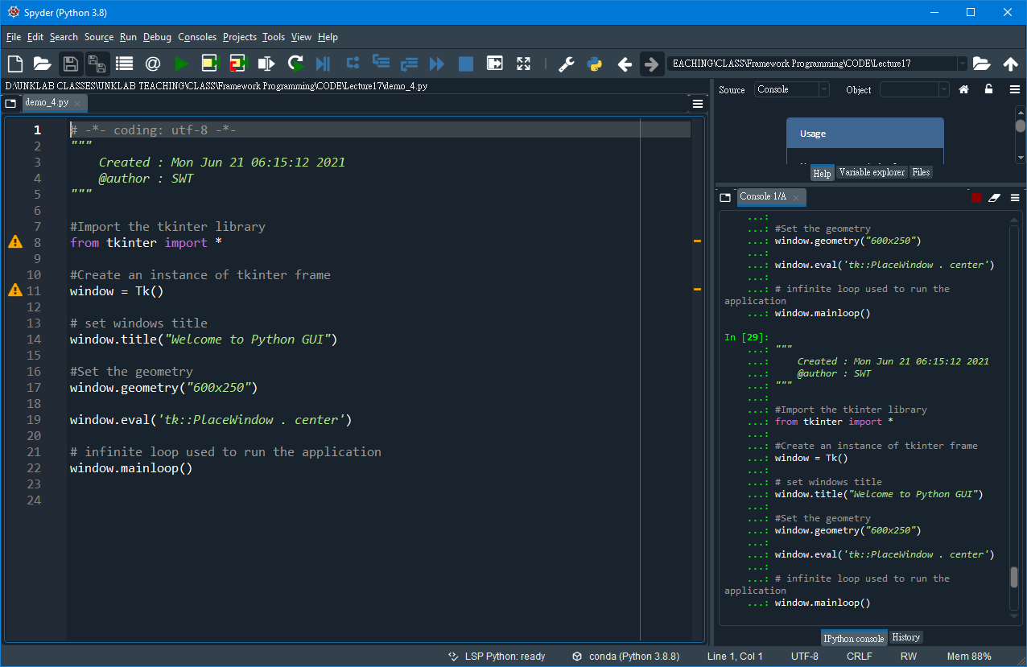
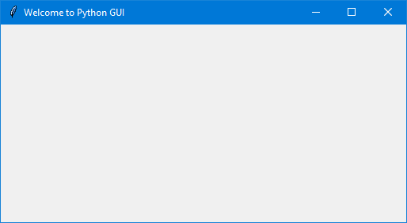
Exercise #4
File : demo_4.py
Desc : How to center a window on the screen in Tkinter?
Output Program:
In order to place a tkinter window at the center of the screen, we can use the PlaceWindow method in which we can pass the toplevel window as an argument and add it into the center.

Slide 18
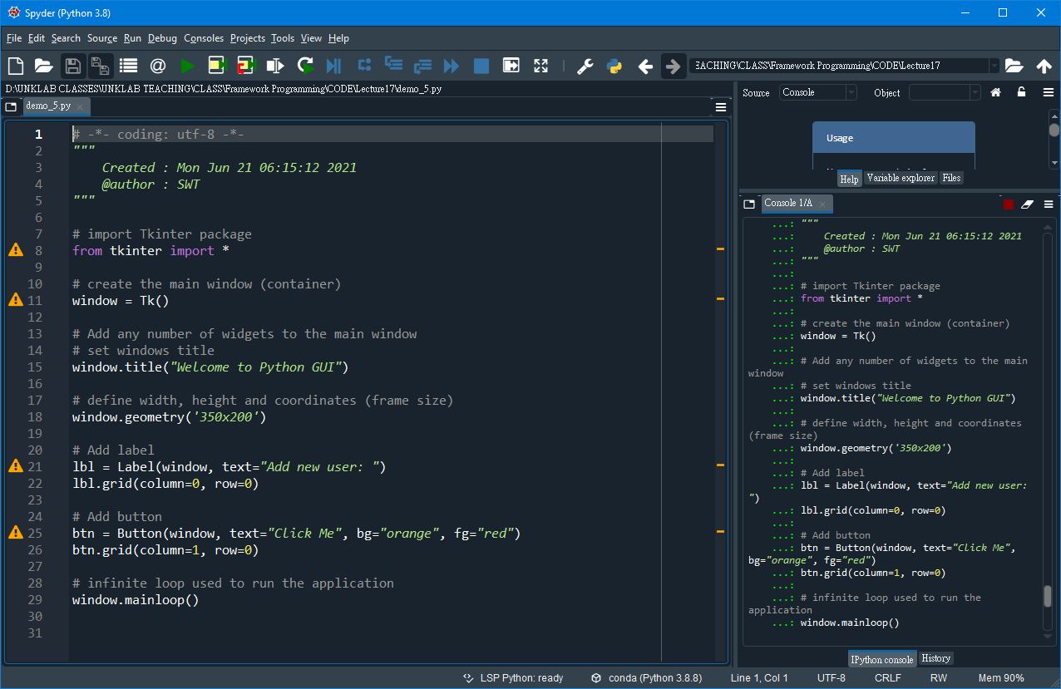
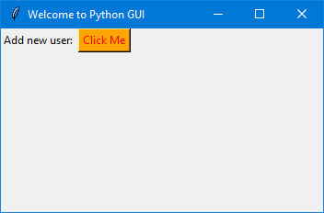
Exercise #5
File : demo_5.py
Desc : Change button foreground and background colors
Output Program:
Set the following important properties to customize a button:
text : caption of the button
bg : background colour
fg : foreground colour
font : font name and size
image : to be displayed instead of text
command : function to be called when clicked

Slide 19
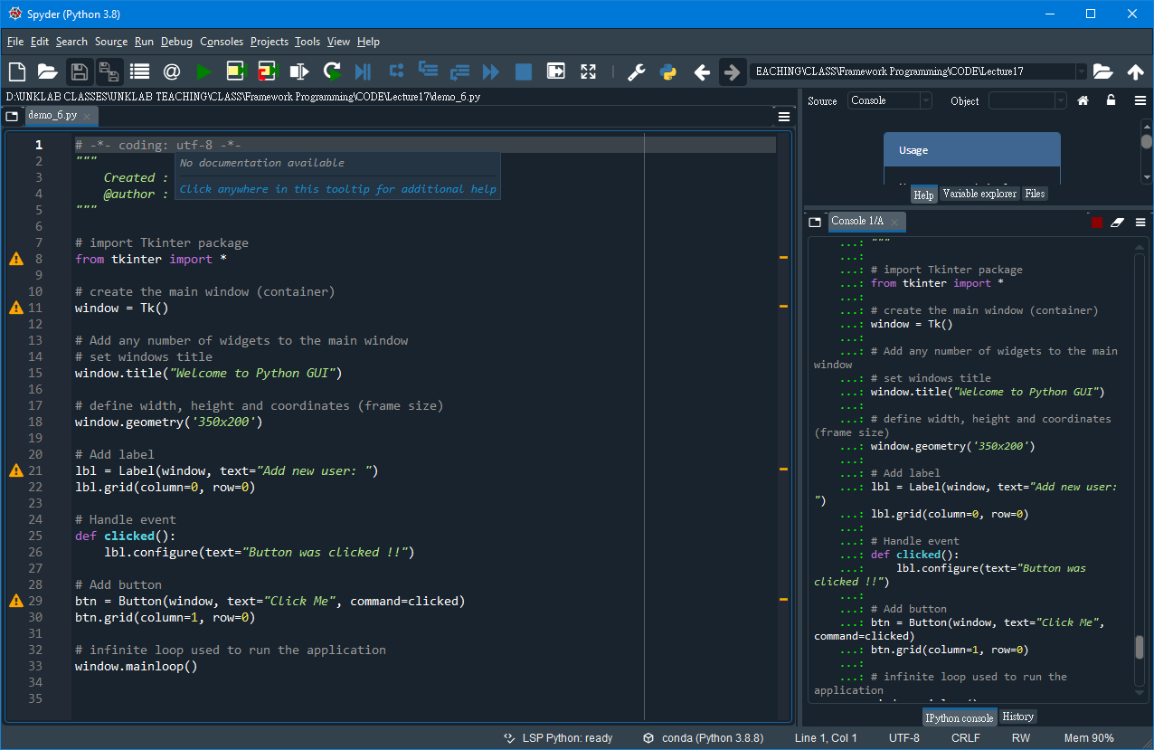
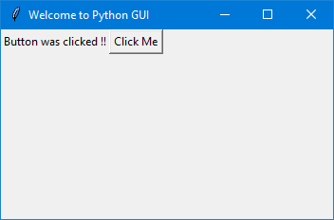
Exercise #6
File : demo_6.py
Desc : Handle button click event
Output Program:
Write a function that we need to execute when the button is clicked.

Slide 20
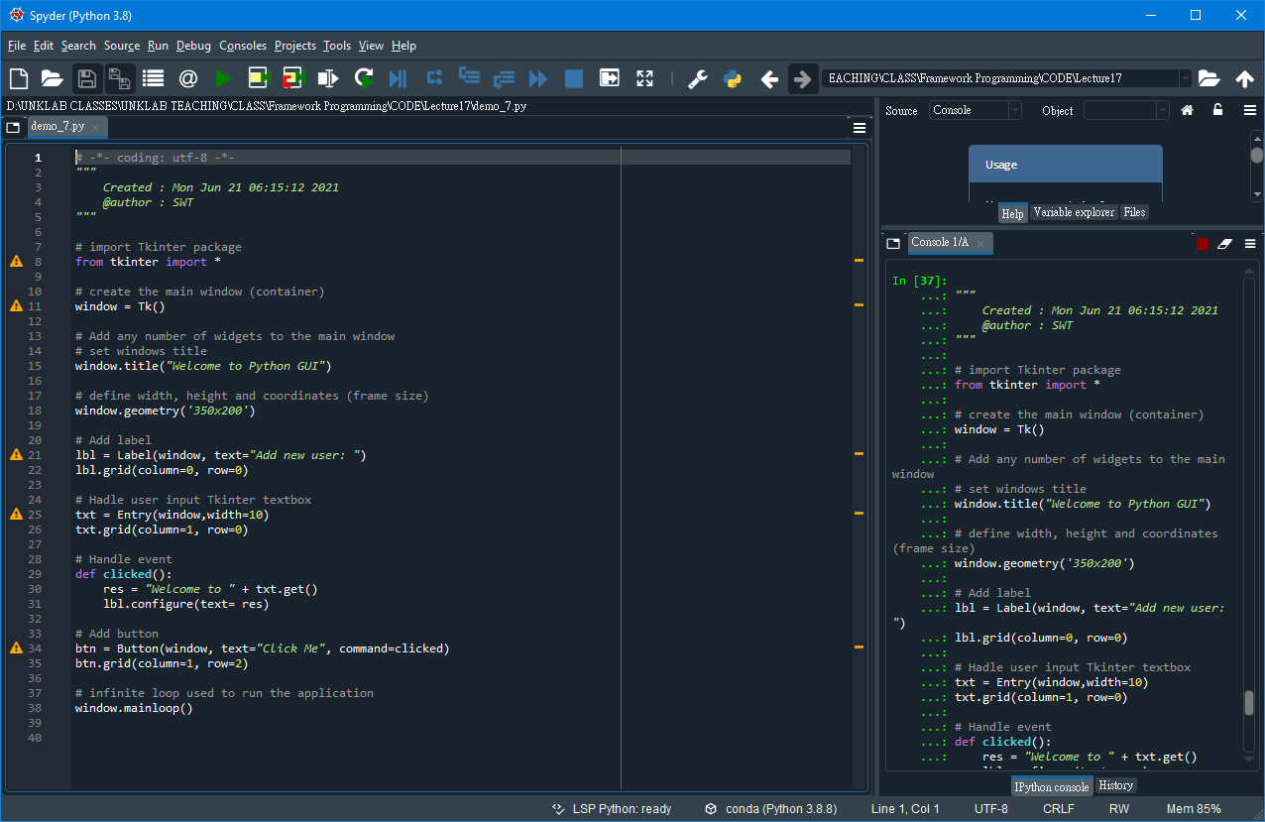
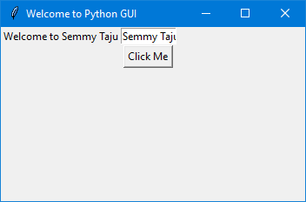
Exercise #7
File : demo_7.py
Desc : Get/handle user input “text” using Entry class (Tkinter textbox) or textfield.
Output Program:
If you click the button and there is a text on the entry widget, it will show “Welcome to” concatenated with the entered text.

Slide 21
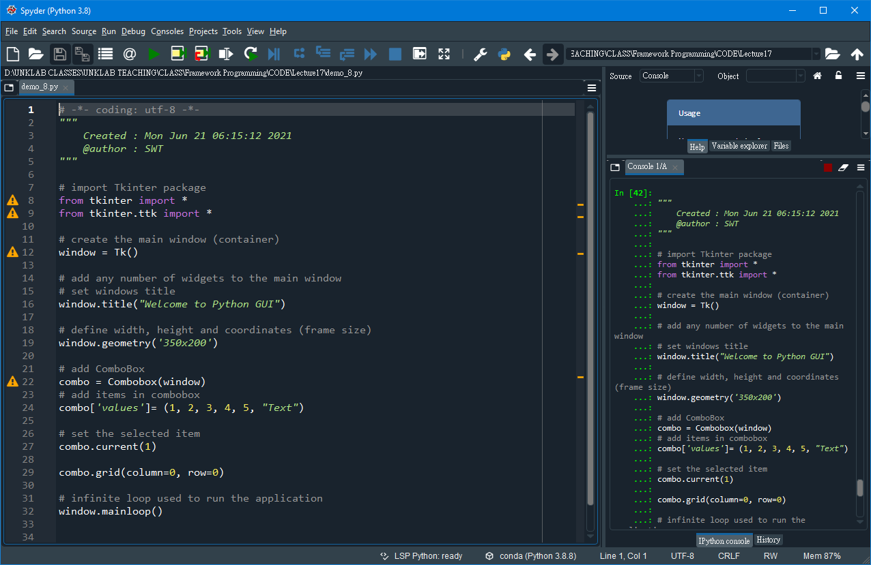
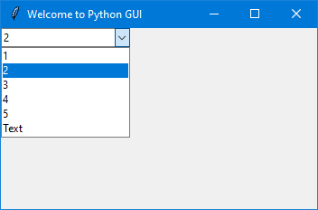
Exercise #8
File : demo_8.py
Desc : Add a combobox widget
Output Program:

Slide 22
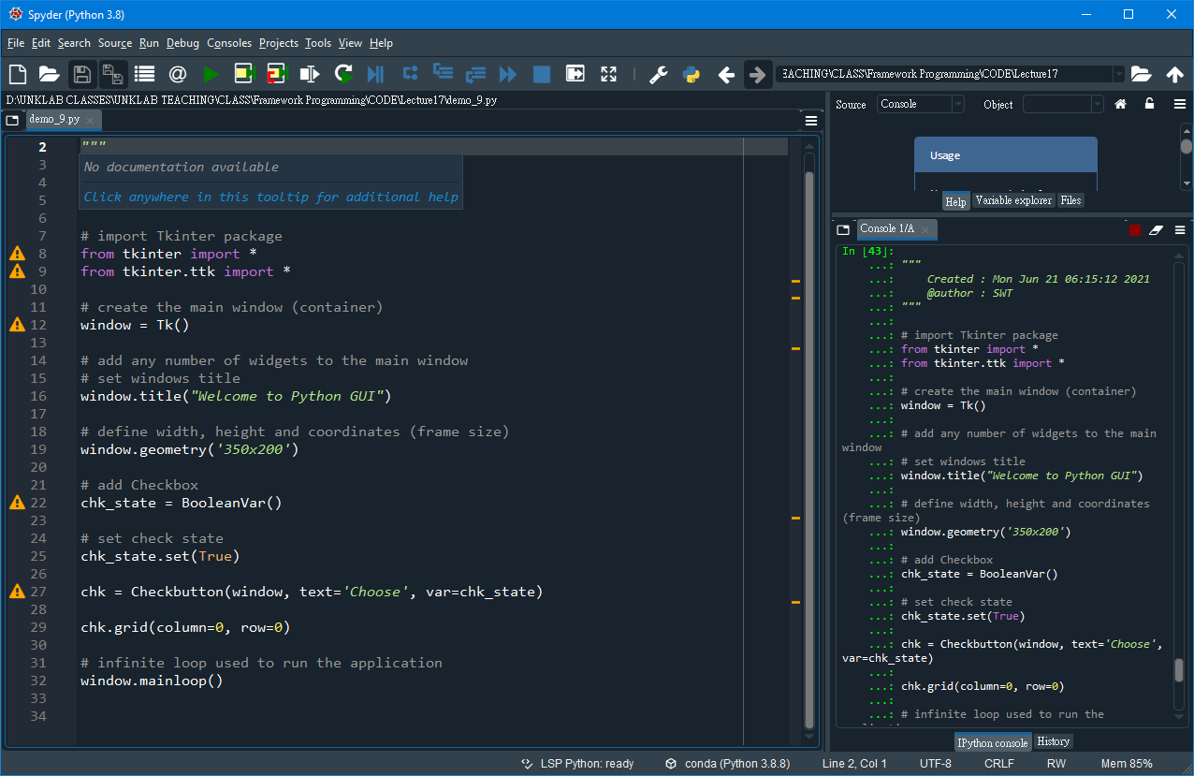
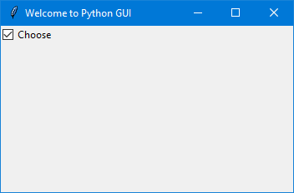
Exercise #9
File : demo_9.py
Desc : Add a Checkbutton widget (Tkinter checkbox)
Output Program:

Slide 23
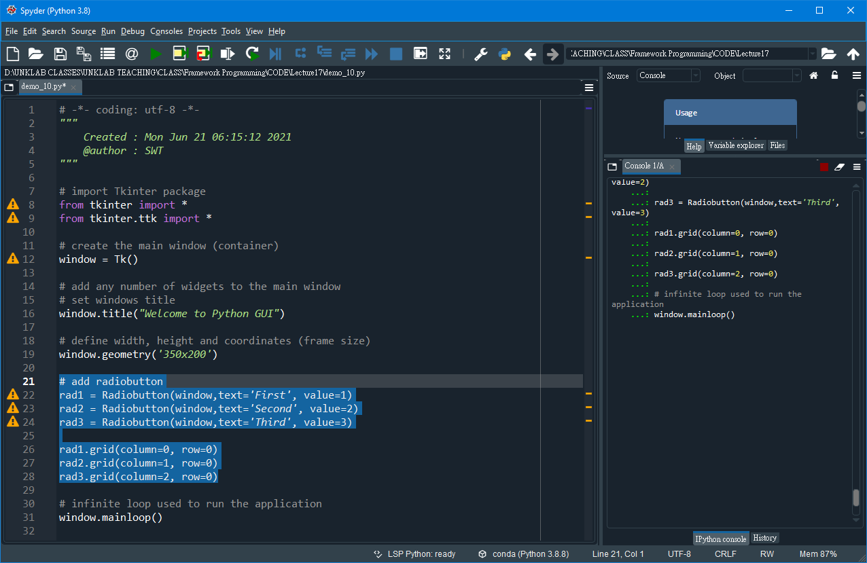
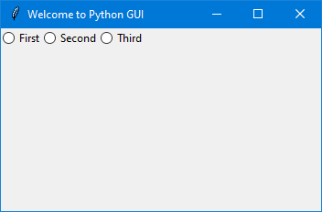
Exercise #10
File : demo_10.py
Desc : Add radio buttons widgets
Output Program:

Slide 24
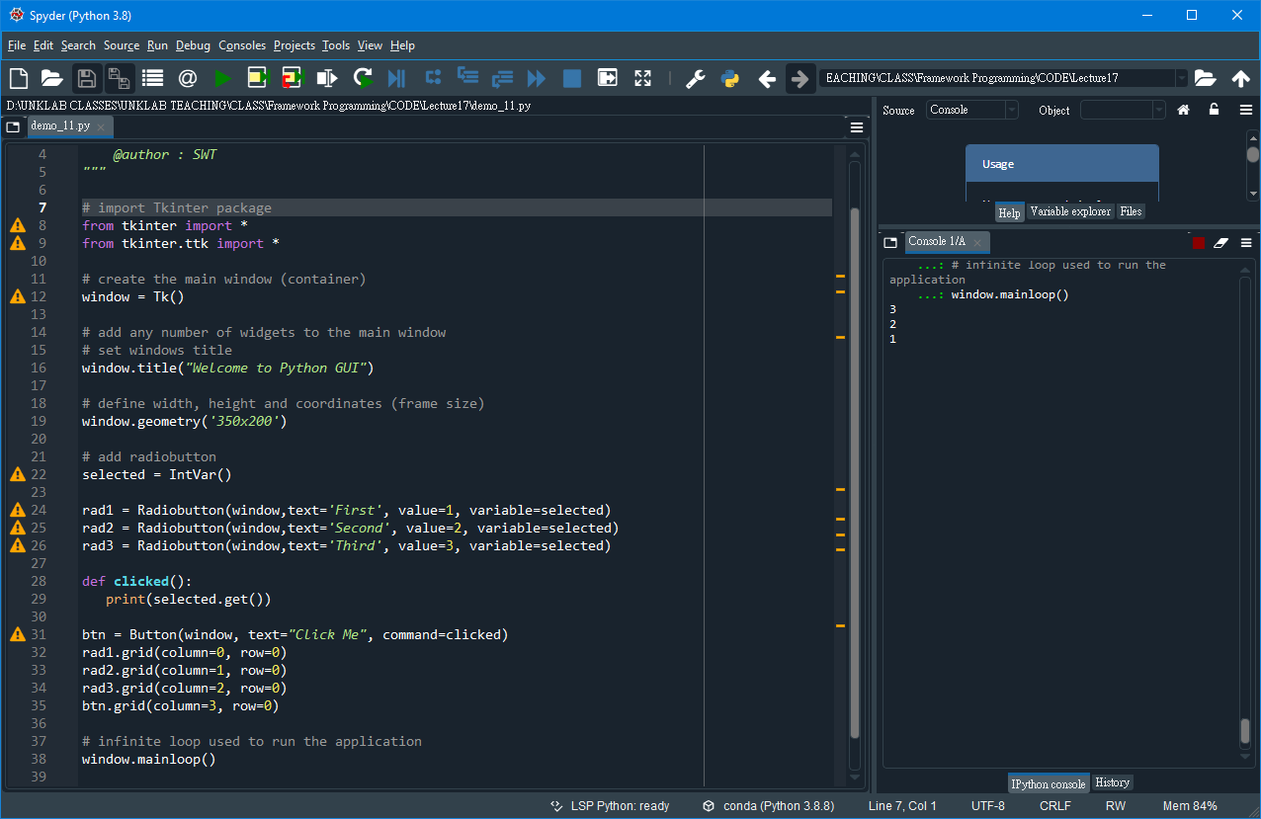
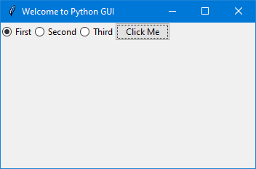
Exercise #11
File : demo_11.py
Desc : Get radio button value (selected radio button)
Output Program:

Slide 25
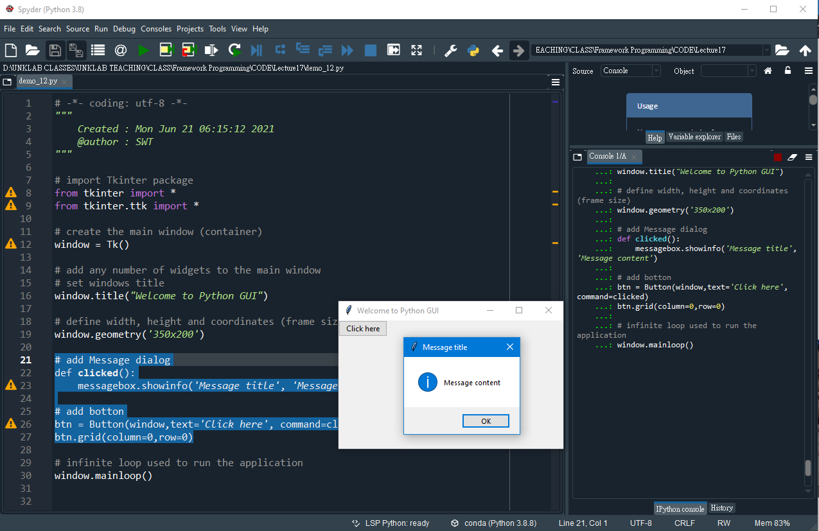
Exercise #12
File : demo_12.py
Desc : Create a MessageBox

Slide 26
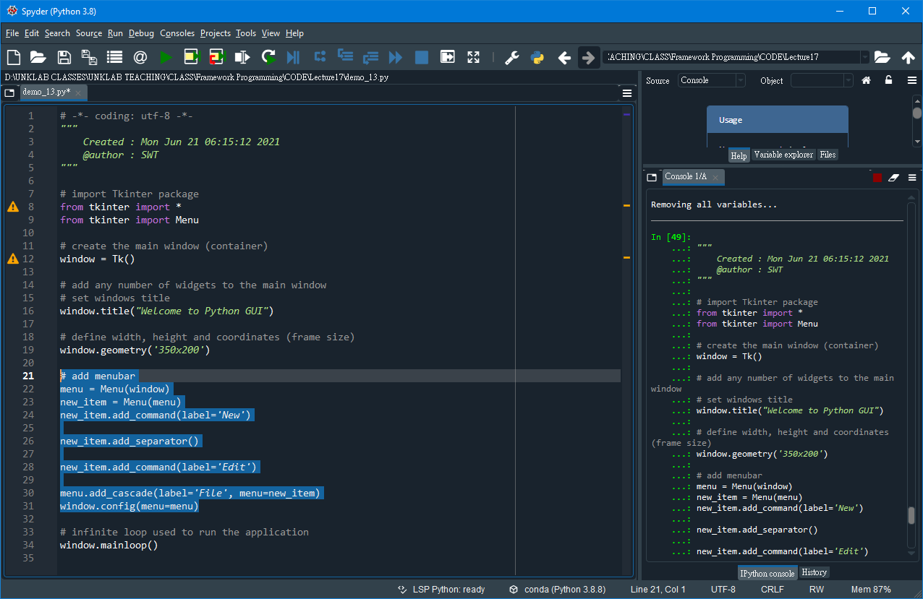
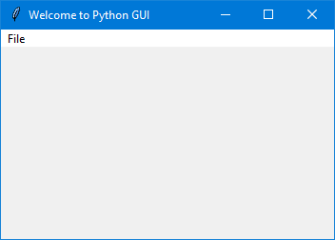
Exercise #13
File : demo_13.py
Desc : Add a Menu bar
Output Program:

Slide 27
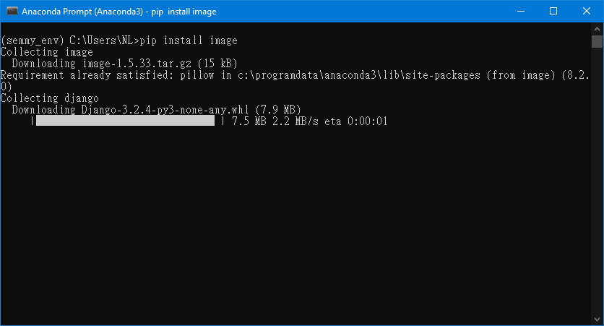
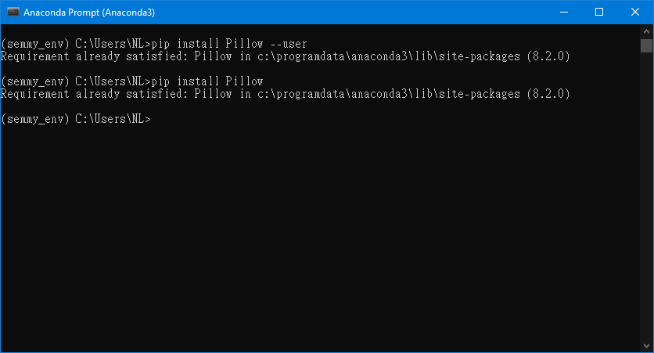
ModuleNotFoundError?
ModuleNotFoundError: No module named 'Image'

Slide 28
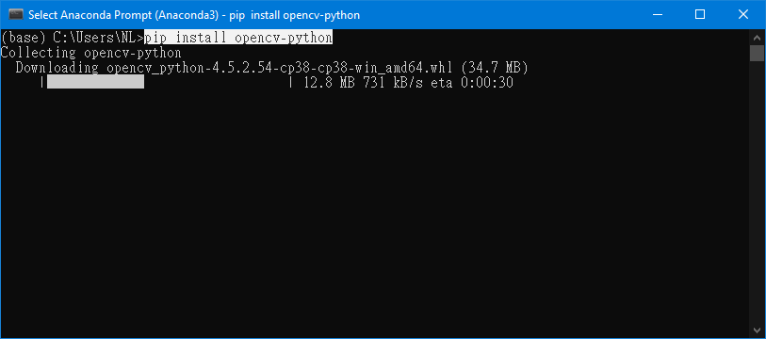
Install OpenCV Package
Install OpenCV on the platform via pip:

Slide 29
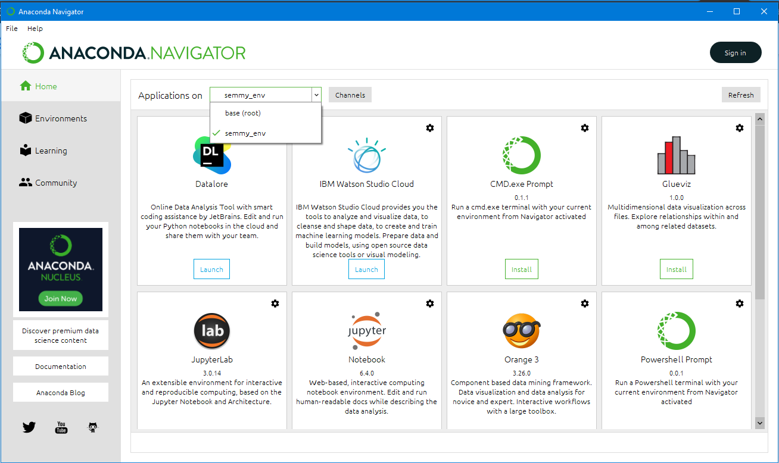
Switch Between Environments in Anaconda Navigator

Slide 30
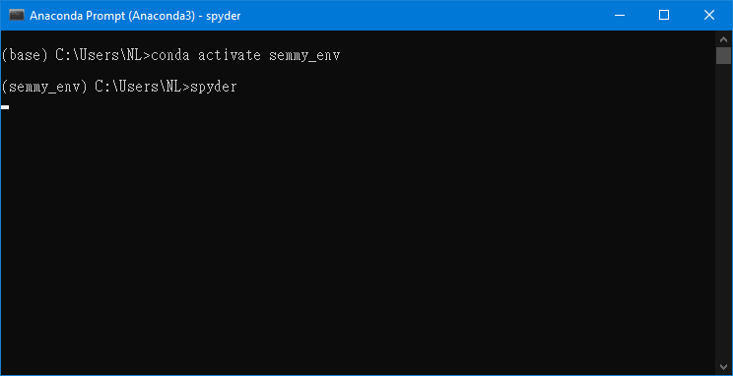
Activate an Anaconda Environment

Slide 31
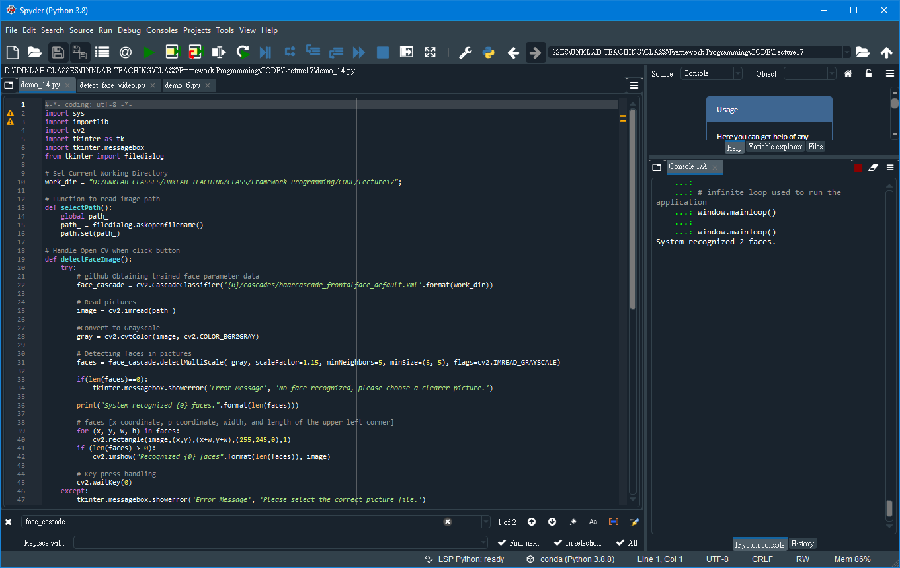
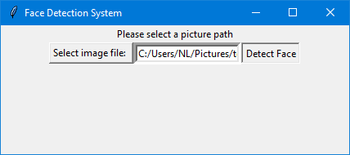
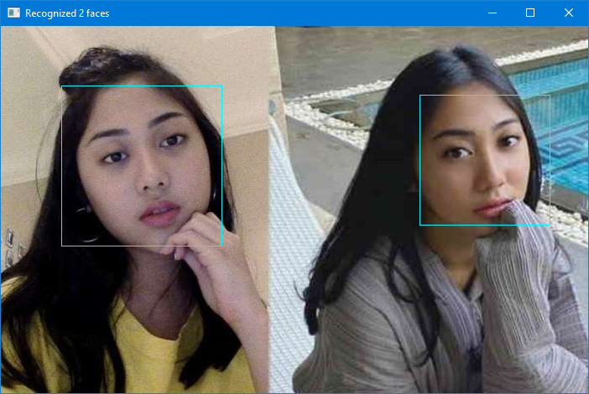
Exercise #14
File : demo_14.py
Desc : Pthon3, tkinter (GUI) and openCV to develop a simple Face Detection System

Slide 32
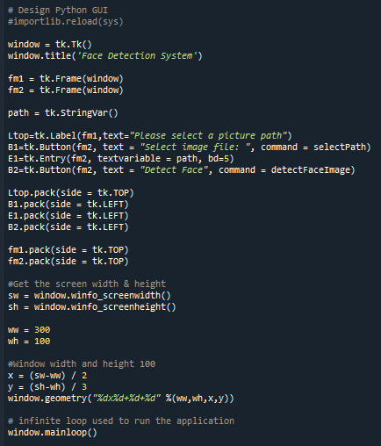
Exercise #14
File : demo_14.py
Desc : Python3, tkinter (GUI) and openCV to develop a simple Face Detection System

Slide 33
2 - Install Flask on Windows
[Web Application Framework with Python]

Slide 34
What is Flask?
Flask is a web application framework written in Python. It is developed by Armin Ronacher, who leads an international group of Python enthusiasts named Pocco. Flask is based on the Werkzeug WSGI toolkit and Jinja2 template engine. Both are Pocco projects.
WSGI Web Server Gateway Interface (WSGI) has been adopted as a standard for Python web application development. WSGI is a specification for a universal interface between the web server and the web applications.
Werkzeug It is a WSGI toolkit, which implements requests, response objects, and other utility functions. This enables building a web framework on top of it. The Flask framework uses Werkzeug as one of its bases.
Jinja2 Jinja2 is a popular templating engine for Python. A web templating system combines a template with a certain data source to render dynamic web pages.

Slide 35
Prerequisites (prasyarat)
Installed Python 2.7 or Python 3.5 and newer.
Command-line interface (CLI) with administrator privileges.

Slide 36
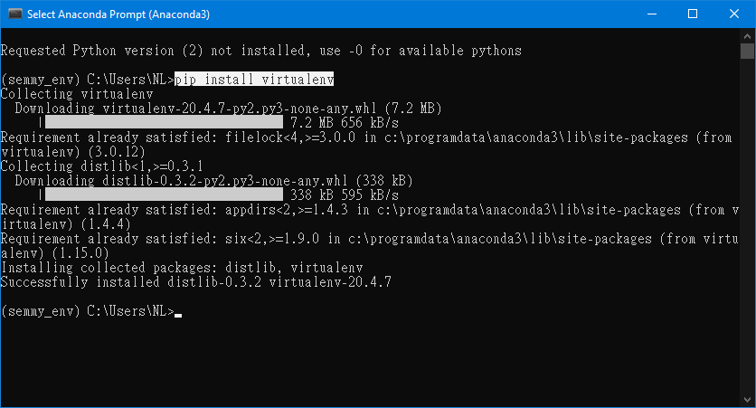
Step 1: Install Virtual Environment
Install Flask in a virtual environment to avoid problems with conflicting libraries.
Check Python version before starting:
Python 3 comes with a virtual environment module called venv preinstalled. If you have Python 3 installed, skip to Step 2.
Python 2 users must install the virtualenv module. If you have Python 2, follow the instructions outlined in Step 1.
Install virtualenv on Windows:
1. Open the command line with administrator privileges.
2. Use pip to install virtualenv on Windows: pip install virtualenv

Slide 37
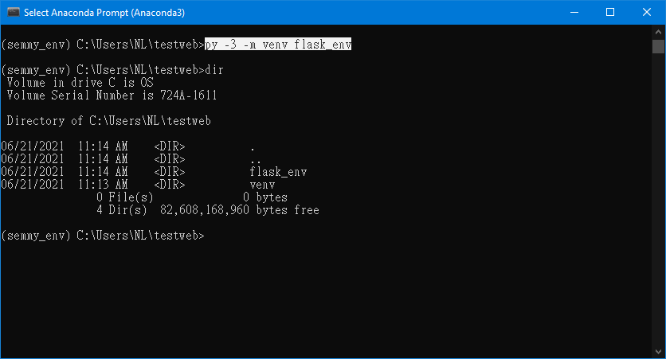
Step 2: Create an Environment
Make a separate directory for your project: $ mkdir testweb
Move into the directory: $ cd testweb
Within the directory, create the virtual environment for Flask. When you create the environment, a new folder appears in your project directory with the environment’s name.
Create an Environment in Windows For Python 3:
Create and name a virtual environment in Python 3 with:
$ py -3 -m venv <name of environment>
or
$ python-m venv <name of environment>

Slide 38
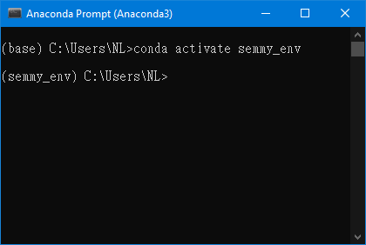
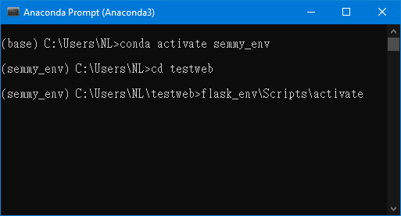
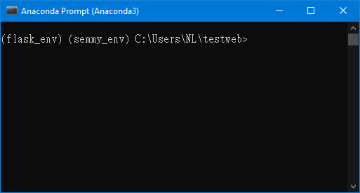
Step 3: Activate the Environment
1. Activate conda Environment on Windows:
2. Activate the Virtual Environment for flask
For Windows, activate the virtual environment.
3. Activated Virtual Environment

Slide 39

Step 4: Install Flask
Install Flask within the activated environment using pip:
$ pip install Flask

Slide 40


Step 5: Test the Development Environment
Create a simple Flask application to test the newly created development environment.
Make a file in the Flask project folder called hello.py.
Edit the file using a text editor and add the following code to make an application that prints “Hello world!”.
Note: Pick any name for the project except flask.py. The Flask library is in a flask.py file.
Dir path: C:\Users\NL\testweb

Slide 41


Set FLASK_APP environment variable
Open new console (CMD) to navigate to the project folder using the cd command.
Set the FLASK_APP environment variable.
1. For Linux and Mac:
$ export FLASK_APP=hello.py
2. For Windows:
$ setx FLASK_APP “hello.py”

Slide 42

Run the Flask Application
Run the Flask application with:
$ flask run
Copy and paste this URL in your browser: http://127.0.0.1:5000/

Slide 43

Run the Flask Application
Check your browser:

Slide 44
After Run Flask Application
Note: Windows users must restart/close the console (CMD) to set the environment variable.

Slide 45
(#2) exercise for students
[Web Framework]

Slide 46



Exercise #2.1
File : demo_2_1.py
Desc : Display/create/build first python website using the Flask framework.
Output Program:

Slide 47


Exercise #2.2
File : demo_2_3.py
Desc : Flask App routing
Output Program:

Slide 48


Exercise #2.3
File : demo_2_3.py
Desc : Flask App routing
Output Program:

Slide 49
Exercise #2.4
File : demo_2_4.py
Desc : Python3, Flask and OpenCV
Create an example for openCV object detection with python flask application.

Slide 50
Reference (GUI Frameworks)
How To Install Tkinter In Windows
https://www.activestate.com/resources/quick-reads/how-to-install-tkinter-in-windows/
How to install Tkinter in Python?
https://www.tutorialspoint.com/how-to-install-tkinter-in-python
Python GUI Programming With Tkinter
https://realpython.com/python-gui-tkinter/
Python - GUI Programming (Tkinter)
https://www.tutorialspoint.com/python/python_gui_programming.htm
Introduction to GUI With Tkinter in Python
https://www.datacamp.com/community/tutorials/gui-tkinter-python
Python Tkinter Tutorial
https://www.geeksforgeeks.org/python-tkinter-tutorial/
Introduction to GUI programming with tkinter
https://python-textbok.readthedocs.io/en/1.0/Introduction_to_GUI_Programming.html
Create UI in Python-Tkinter
https://www.tutorialsteacher.com/python/create-gui-using-tkinter-python
Python GUI examples (Tkinter Tutorial)
https://likegeeks.com/python-gui-examples-tkinter-tutorial/
Python GUI – tkinter
https://www.geeksforgeeks.org/python-gui-tkinter/

Slide 51
Reference (Web Frameworks)
Python Flask Tutorial – Introduction To Flask For Beginners
https://www.softwaretestinghelp.com/python-flask-tutorial/
Flask Mega-Tutorial
https://blog.miguelgrinberg.com/post/the-flask-mega-tutorial-part-i-hello-world
Why is Flask a good web framework choice?
https://www.fullstackpython.com/flask.html
Python Flask Windows Development Environment Setup
https://timmyreilly.azurewebsites.net/python-flask-windows-development-environment-setup/
Install Flask and create your first web application
https://dev.to/sahilrajput/install-flask-and-create-your-first-web-application-2dba
How to install FLASK in Windows 10
https://www.osradar.com/how-to-install-flask-in-windows-10/
How To Install Flask
https://phoenixnap.com/kb/install-flask
How To Make a Web Application Using Flask in Python
https://www.digitalocean.com/community/tutorials/how-to-make-a-web-application-using-flask-in-python-3
Flask Tutorials
https://realpython.com/tutorials/flask/
What is Flask?
https://www.tutorialspoint.com/flask/flask_overview.htm
Python Flask Tutorial
https://www.javatpoint.com/flask-tutorial
How to build a web application using Flask
https://www.freecodecamp.org/news/how-to-build-a-web-application-using-flask-and-deploy-it-to-the-cloud-3551c985e492/

Slide 52

THANK YOU
END PRESENTATION
Thank you for your attention
Instructor: S – W – T

